Slide 1
🏛️ AI-Powered Civic Connect: Smart Public
Grievance Management System
A Web-Based Intelligent Platform for Public Complaint Management
Sejal Heda (2510030350)
Bhavya Potnuru(2510030379)
Thota Lakshmi Hansika(2510030330)
Bachangari Siri(2510030325)
Macharla Mounika(2510030343)
Under the Guidance of:
Dr.P Lalitha Surya Kumari

Slide 2
Problem Statement & Objectives
Problem Statement
Objectives of CivicConnect
Traditional complaint management systems face:
  Duplicate complaints for the same civic issue
  Manual priority assignment
  Difficulty identifying responsible departments
  Lack of geographical information
  Poor complaint tracking
  No separation between citizen and administrator access
Digitize public complaint registration
Detect possible duplicate complaints
Increase priority when duplicate reports increase
Automatically assign responsible departments
Capture complaint location
Allow citizens to view only their own complaints
Provide an administrator dashboard
Track complaint status

Slide 3
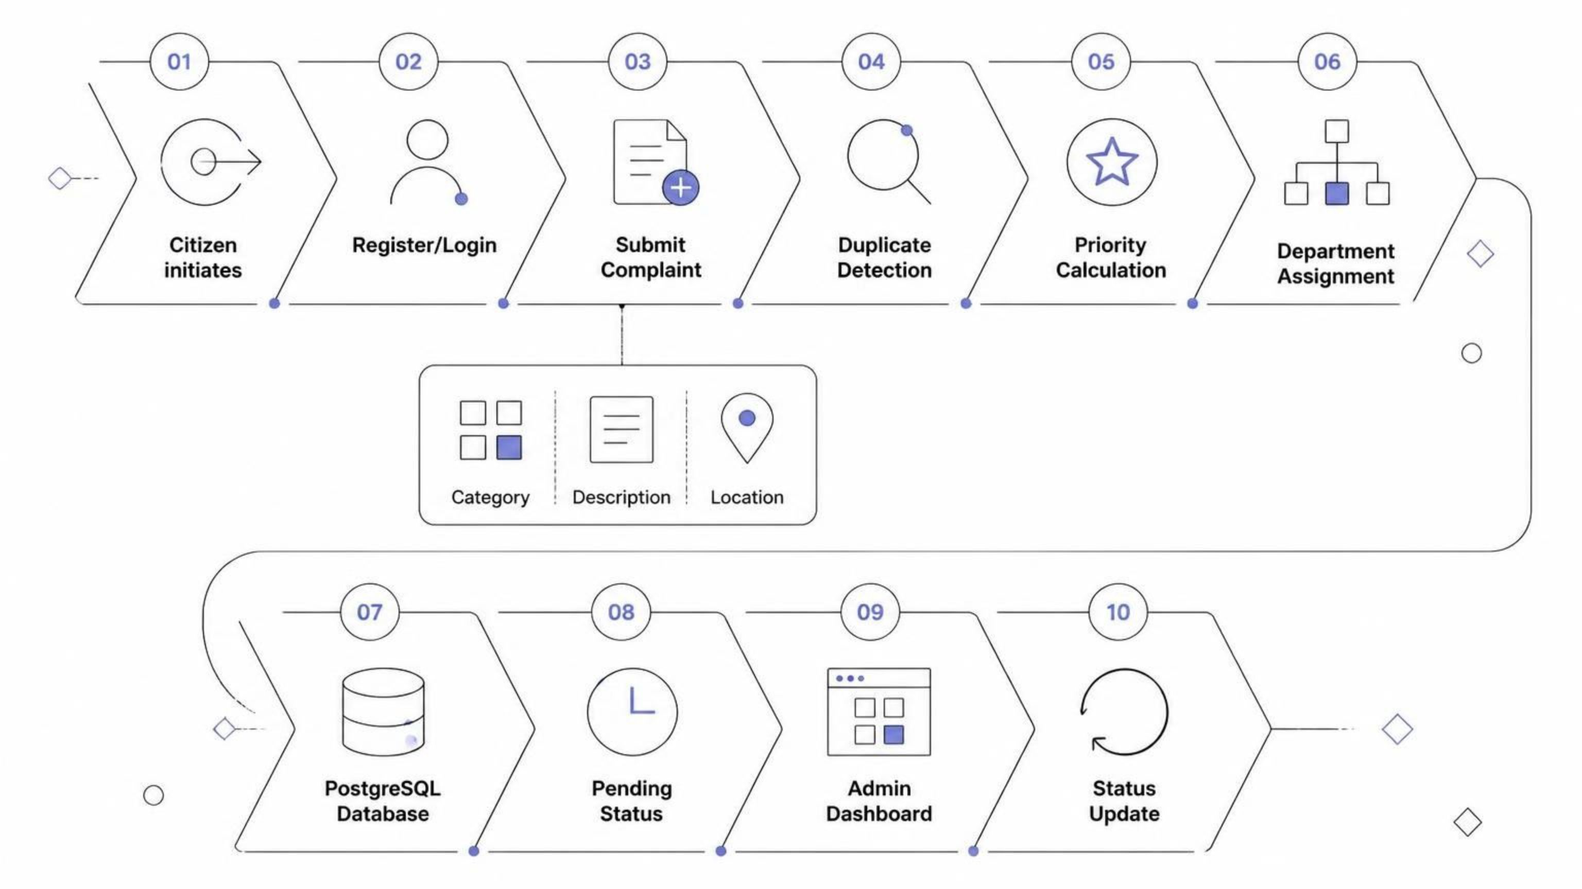
Proposed Methodology & Novelty
CivicConnect Workflow

Slide 4
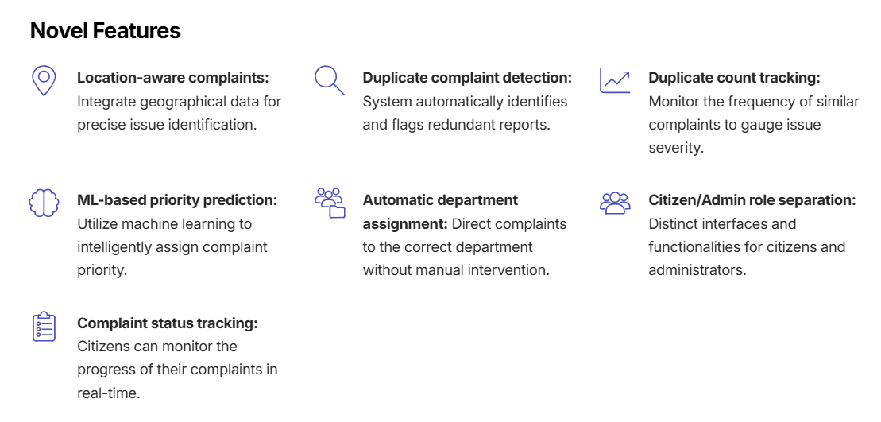
Main Novelty
Multiple reports of the same civic issue are consolidated into one issue on the Admin Dashboard, while the duplicate count is increased and contributes to priority.

Slide 5
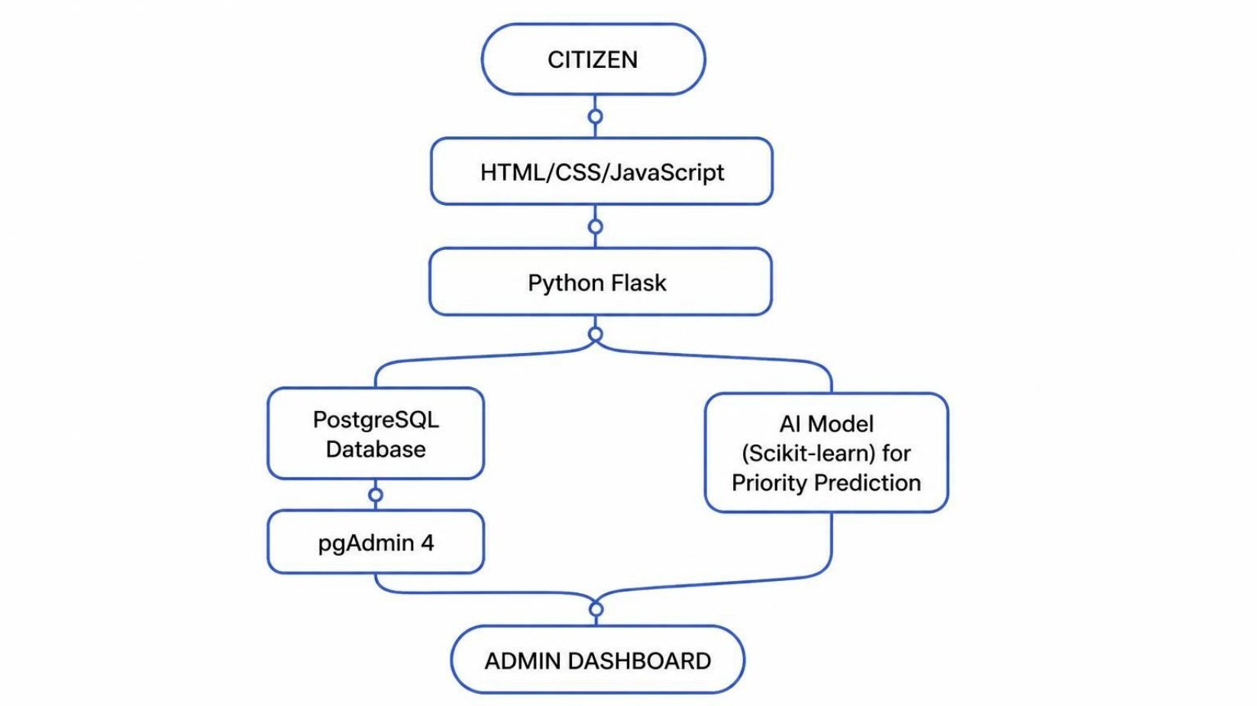
System Architecture & Backend
System Architecture Diagram
Backend Concepts - Python Flask
Routing
Request handling
Form processing
Sessions
Authentication
Database operations
Database Connection
Flask → psycopg2 → PostgreSQL

Slide 6
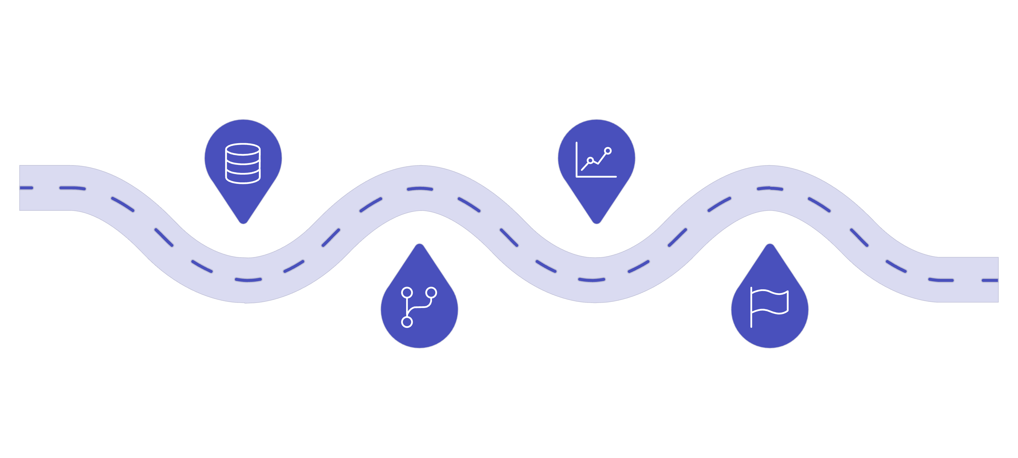
🤖 Machine Learning Component: Priority Prediction
Algorithm
Algorithm: Logistic Regression
We use supervised machine learning to predict an additional priority level.
Text Processing - TF-IDF:
Input Features:
TF-IDF = Term Frequency–Inverse Document Frequency
It converts complaint text into numerical features.
Example: "Garbage overflowing near hospital" → TF-IDF Vector → Numerical Features
Categorical Processing - One-Hot Encoding:
Complaint description
Complaint category
Location type
Duplicate count
Complaint category
Location type
Model Flow:
Logistic Regression
Input Data
Complaint text and metadata
Supervised model training and inference
TF-IDF and one-hot encoding
Assigned priority label output
Feature Engineering
Predicted Priority

Slide 7
📍 Location Detection
Current Location
Manual Location
Location Type
When the citizen clicks "📍 Use My Current Location":
JavaScript uses:
If the citizen does not want to share current location, they can manually enter:
The citizen can select:
Hospital
School
Highway
Market
Residential Area
Public Area
Open Plot
Other
Latitude: 17.362842
Longitude: 78.421379
navigator.geolocation.getCurrentPosition(
function(position) {
const lat = position.coords.latitude;
const lon = position.coords.longitude;
}
);
The browser requests permission and provides:
Latitude
Longitude
Accuracy

Slide 8




🔍 Duplicate Complaint Detection
The purpose is to prevent the Admin Dashboard from displaying the same civic issue repeatedly.
Category Check
Location Check
Complaint Similarity
Compare: New Complaint Category = Previous Complaint Category
Example: Sewerage & Drainage = Sewerage & Drainage
Use latitude and longitude.
Haversine Formula: Calculates the geographical distance between two coordinate points.
Latitude + Longitude → Haversine Formula → Distance in metres → ≤ 100 metres
We compare complaint descriptions using: TF-IDF + Cosine Similarity
Example:
Complaint 1: "Drainage water is overflowing near hospital"
Complaint 2: "Sewage is flowing outside hospital"
If the complaints are sufficiently similar and geographically close, they are treated as possible duplicates.
Admin Consolidation
Database:
Admin Dashboard:
ID 1 → Original
ID 5 → Duplicate
ID 8 → Duplicate
ID 1
Duplicate Count = 2
ID 5 and ID 8 are not shown separately to the admin.
IMPORTANT NOTE: Duplicate records are retained in the database for traceability but consolidated in the Admin Dashboard.

Slide 9
⚡ Dynamic Complaint Priority
Priority Formula:
Final Priority = Base Priority + Location Bonus + Duplicate Count
Maximum Score = 10
Location Bonus Table
Priority Levels Table
Duplicate Effect Example
Location | Bonus
Hospital | +4
School | +3
Highway | +3
Market | +2
Residential Area | +1
Other locations | +1
Score | Priority
10 | Critical
8–9 | High
5–7 | Medium
1–4 | Low
Base Priority = 6
Hospital Bonus = 4
Duplicate Count = 2
6 + 4 + 2 = 12
Maximum score: Final Priority = 10 🔴 Critical
As the number of duplicate reports increases, the priority score increases.

Slide 10
👤 Citizen vs Administrator
Citizen Portal
Administrator Portal
Status Tracking & Database
Register
Login
Submit complaint
Enter location
View My Complaints
Check priority
Check duplicate count
Track status
Only authorized administrator can access the complete dashboard.
Status Tracking:
Pending → Under Review → Assigned → In Progress → Resolved
Admin Login:
Email: abc@gmail.com
Password: ******
PostgreSQL Tables:
Citizen
Category
Department
Location
Status
Complaint
ComplaintReporter
View consolidated complaints
View priority
View duplicate count
View department
View location
View citizen information
Update complaint status
Privacy:
Citizen A → My Complaints → Only Citizen A's complaints
A citizen cannot see all complaints registered by other citizens.

Slide 11
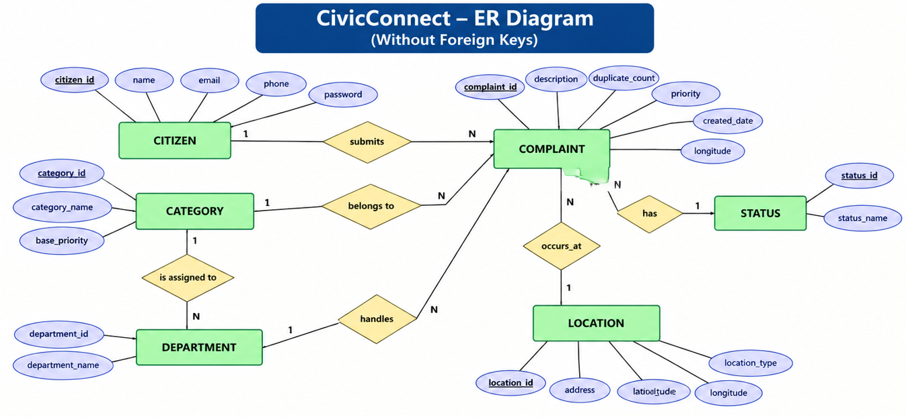

Slide 12
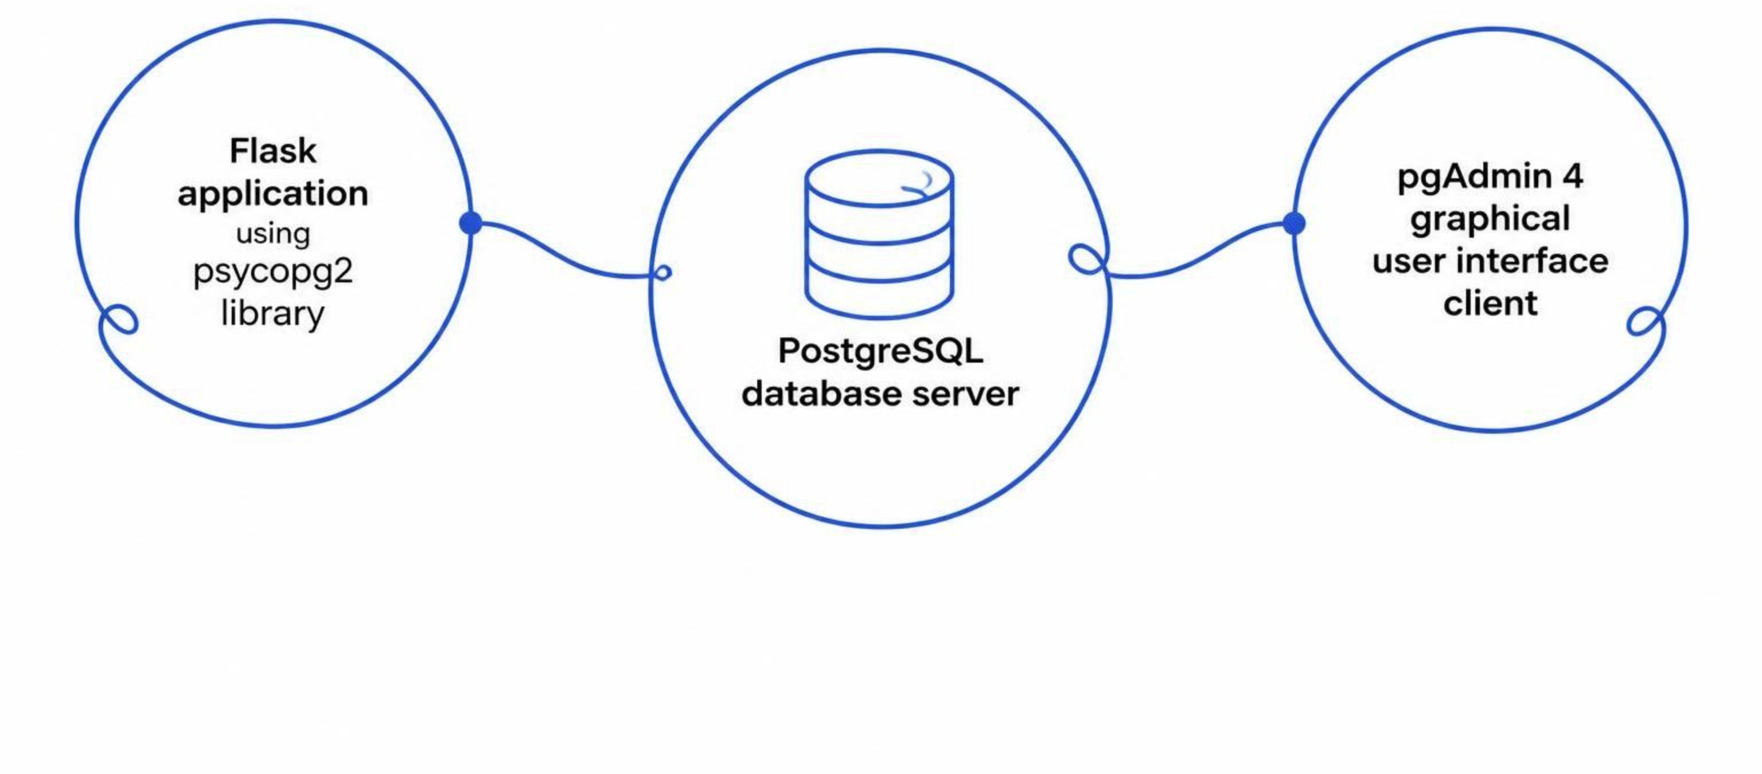
🗄️ PostgreSQL & pgAdmin 4, Evaluation, Adaptability & Future Scope
PostgreSQL & pgAdmin 4
PostgreSQL = actual database server
Flask = application that connects to PostgreSQL
psycopg2 = Python PostgreSQL connector
pgAdmin 4 = GUI used to manage/view PostgreSQL
Both Flask and pgAdmin work with the same PostgreSQL database.
Important Concept:
Flask does NOT connect to pgAdmin.
Instead:
Methodology Evaluation:
AI Evaluation:
Adaptability & Future Scope:
Complaint registration
Login and role access
Database integration
Duplicate detection
Priority calculation
AI prediction
Department assignment
Status tracking
Dashboard consolidation
Training dataset
Testing dataset
Accuracy
Classification report
Sample predictions
Adaptability:
Different cities
Different complaint categories
Different government departments
Different priority rules
Different duplicate-distance thresholds
Larger datasets
More advanced ML models
Future Scope:
📱 Mobile application
🗺️ Interactive complaint map
🔔 SMS/email notifications
📈 Analytics dashboard
🧠 Advanced NLP
📷 Image-based complaint analysis
🌐 Multi-language support
CivicConnect combines web technology, relational database management, geolocation, machine learning and role-based access to create an intelligent and scalable public grievance management system.

Slide 13
Methodology and Future Scope
Methodology Evaluation:
Complaint registration
Login and role access
Database integration
Duplicate detection
Priority calculation
AI prediction
Department assignment
Status tracking
Dashboard consolidation
Adaptability:
Different cities
Different complaint categories
Different government departments
Different priority rules
Different duplicate-distance thresholds
Larger datasets
More advanced ML models
Future Scope:
📱 Mobile application
🗺️ Interactive complaint map
🔔 SMS/email notifications
📈 Analytics dashboard
🧠 Advanced NLP
📷 Image-based complaint analysis
🌐 Multi-language support

